Slide 1
Attention Is All You Need
马海燕
Ashish Vaswani, Noam Shazeer, Niki Parmar, Jakob Uszkoreit, Llion Jones, Aidan N. Gomez, Lukasz Kaiser, Illia Polosukhin
[1706.03762] Attention Is All You Need (arxiv.org)

Slide 2
参考资料
Transformer论文逐段精读【论文精读】_哔哩哔哩_bilibili
【通俗易懂】大白话讲解 Transformer - 知乎 (zhihu.com)
对Transformer中FeedForward层的理解_transformer feed forward_江 东的博客-CSDN博客
Transformer模型详解（图解最完整版） - 知乎 (zhihu.com)
(9 封私信 / 81 条消息) 如何理解Transformer论文中的positional encoding，和三角函数有什么关系？ - 知乎 (zhihu.com)

Slide 3
Output Probabilities
绘制过程
Softmax
Linear
Add&Norm
Feed Forward
Add&Norm
Add&Norm
Add&Norm
Multi-Head Attention
Feed
Forward
N×
N×
Add&Norm
Add&Norm
Add&Norm
Masked
Multi-Head Attention
Multi-Head Attention
Positional Encoding
Positional Encoding
Outputs Embedding
Outputs Embedding
Inputs
Outputs
(Shifted right)

Slide 4
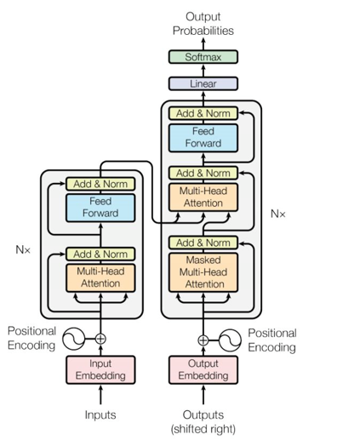
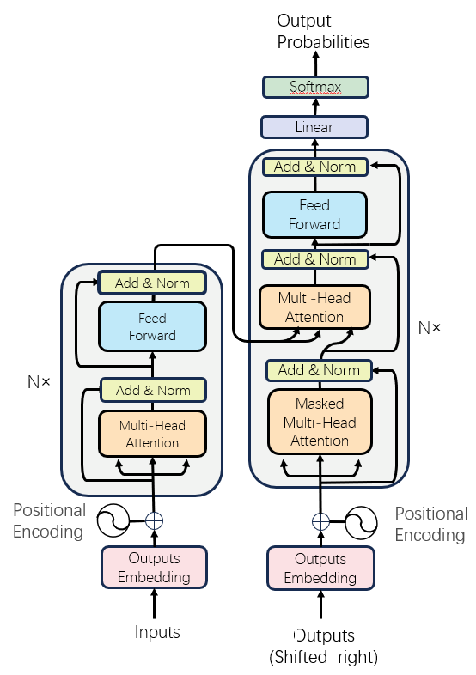
与原图对比

